Slide 1
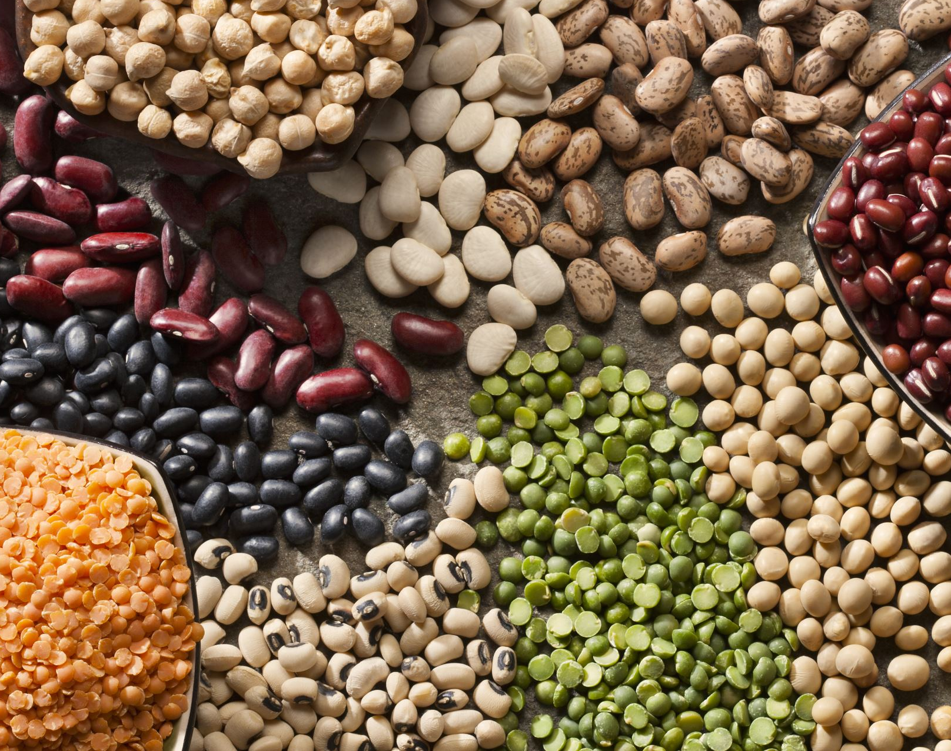
Dry Beans Prediction
Tolu Agunbiade
Jan 2022

Slide 2
Dataset Description
The dataset used for this project is obtained from the popular University of California, Irvine (UCI) Machine Learning Repository.
The data is derived from a research done to identify and gather information about seven different types of dry beans, taking into account the beans’ features such as form, shape, and structure.
The data has 13,611 rows and 16 columns to represent the features of the beans and 1 column that shows the class that each beans belongs to.
This is a supervised learning challenge, where the objective is to use the features in the dataset to classify the beans into their different classes

Slide 3
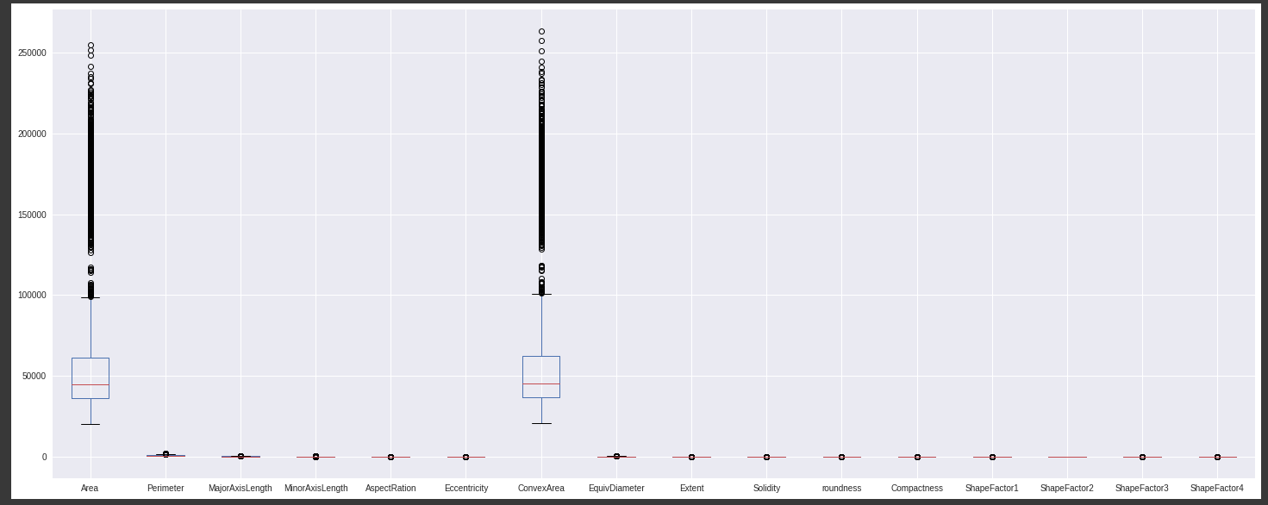
Exploratory Visuals and Insights: Box Plots
Fig. 1: Box Plot of Features

Slide 4
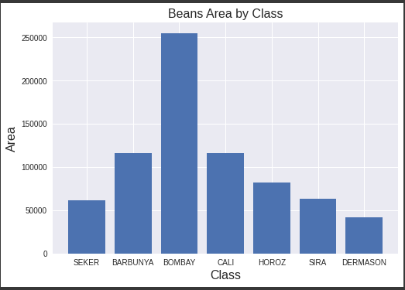
Exploratory Visuals and Insights: Bar Plots
Fig. 2: Bar Plots of Area by Beans Class

Slide 5
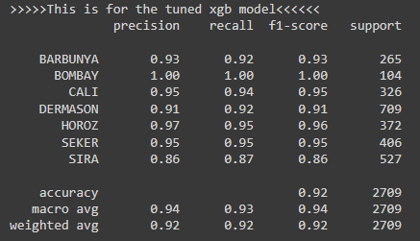
Model Description
Fig 3: Metrics for Tuned XGB Model
Models used for problem: Light GBM vs Extreme Gradient Boosting (XGB)
Both models were tuned, to get the best hyperparameters
Ended up with 4 models in the end, 1 tuned and 1 untuned model for each of Light GBM and XGB
The tuned XGB model performed the best, i.e., returned the best overall accuracy
Accuracy ranged from a high of 100% to a low of 86%

Slide 6
Recommendation
Tuned XGB model looks promising
However, it’s performance on the ‘SIRA’ class of beans at 86% accuracy is a source of worry.
The recommendation at this point would be to obtain more data to train the model in order to improve the accuracy for the ‘SIRA’ class of beans before deploying to production

